Slide 1

Interfacing of Smoke Sensor With BBBW
Submitted By
Amit Kumar

Slide 2
Objectives
Introduction of Smoke Sensor
Requirement
Interfacing with Beaglebone black Wireless
Coding

Slide 3
Requirement For Task
Smoke Sensor MQ2
Jumper Wires
Beagle bone Black Wireless
A Personal Computer/Laptop

Slide 4
MQ sensors
Sensor Name | Gas to measure
MQ-2 | Methane, Butane, LPG, Smoke
MQ-3 | Alcohol, Ethanol, Smoke
MQ-4 | Methane, CNG Gas
MQ-5 | Natural gas, LPG
MQ-6 | LPG, butane
MQ-7 | Carbon Monoxide
MQ-8 | Hydrogen Gas
MQ-9 | Carbon Monoxide, flammable gasses
MQ131 | Ozone
MQ135 | Air Quality
MQ136 | Hydrogen Sulphide gas
MQ137 | Ammonia
MQ138 | Benzene, Toluene, Alcohol, Propane, Formaldehyde gas, Hydrogen
MQ214 | Methane, Natural Gas
MQ216 | Natural gas, Coal Gas
MQ303A | Alcohol, Ethanol, smoke
MQ306A | LPG, butane
MQ307A | Carbon Monoxide
MQ309A | Carbon Monoxide, flammable gas

Slide 5
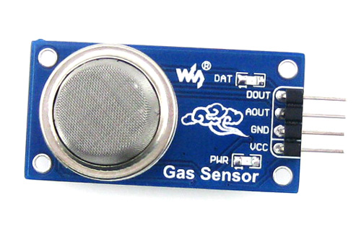
Smoke Sensor MQ2
MQ2 gas sensor is an electronic sensor used for sensing the concentration of gases in the air such as LPG, propane, methane, hydrogen, alcohol, smoke and carbon monoxide.

Slide 6
Smoke Sensor
MQ2 gas sensor is also known as chemiresistor. It contains a sensing material whose resistance changes when it comes in contact with the gas. This change in the value of resistance is used for the detection of gas.
MQ2 is a metal oxide semiconductor type gas sensor. Concentrations of gas in the gas is measured using a voltage divider network present in the sensor.
This sensor works on 5V DC voltage. It can detect gases in the concentration of range 200 to 10000ppm.

Slide 7
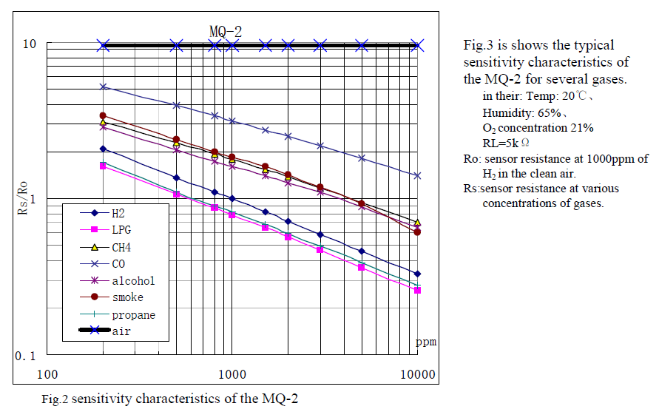
Sensitivity of MQ2 sensor

Slide 8
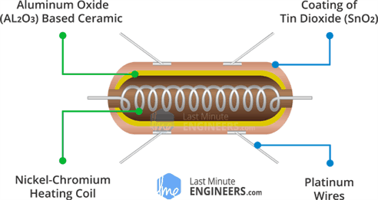
Internal Circuitry of MQ2

Slide 9
Part and Materials used in MQ2 sensor
Gas Sensing Layer | SnO2
2.Electrode | Au
3. Electrode Line | Pt
4. Heater Coil | Ni- Cr Alloy
5. Tubular Ceramic | Al2 O3
6. Anti- explosion Network | Stainless steel gauze
7. Clamp ring | Copper Plating Ni
8.Resin Base | Bakelite
9. Tube Pin | Copper Plating Ni

Slide 10
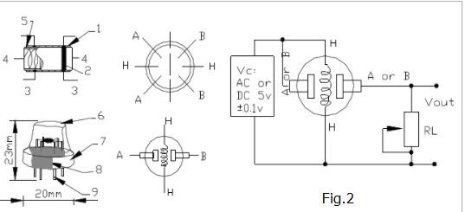
Internal Parts of MQ2 sensor

Slide 11
Working Of MQ2 Smoke Sensor
This sensor contains a sensing element, mainly aluminum-oxide based ceramic, coated with Tin dioxide, enclosed in a stainless-steel mesh. Sensing element has six connecting legs attached to it. Two leads are responsible for heating the sensing element, the other four are used for output signals.
Oxygen gets adsorbed on the surface of sensing material when it is heated in air at high temperature. Then donor electrons present in tin oxide are attracted towards this oxygen, thus preventing the current flow.

Slide 12
Working Of MQ2 Smoke Sensor
When reducing gases are present, these oxygen atoms react with the reducing gases thereby decreasing the surface density of the adsorbed oxygen. Now current can flow through the sensor, which generated analog voltage values.
These voltage values are measured to know the concentration of gas. Voltage values are higher when the concentration of gas is high.

Slide 13
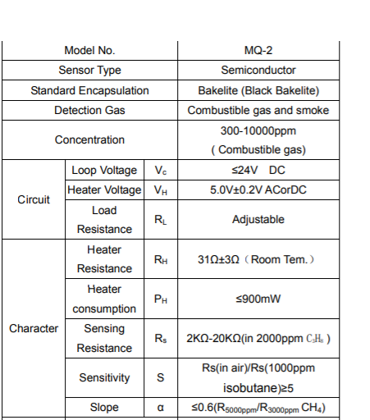
Technical Data

Slide 14
Features of MQ2
Operating Voltage is +5V
Can be used to Measure or detect LPG, Alcohol, Propane, Hydrogen, CO and even methane
Analog output voltage: 0V to 5V
Digital Output Voltage: 0V or 5V (TTL Logic)
Preheat duration 20 seconds
Can be used as a Digital or analog sensor
The Sensitivity of Digital pin can be varied using the potentiometer.

Slide 15
Pin Configuration of MQ2
Pin No: | Pin Name: | Description
For Module
1 | Vcc | This pin powers the module, typically the operating voltage is +5V
2 | Ground | Used to connect the module to system ground
3 | Digital Out | You can also use this sensor to get digital output from this pin, by setting a threshold value using the potentiometer
4 | Analog Out | This pin outputs 0-5V analog voltage based on the intensity of the gas

Slide 16
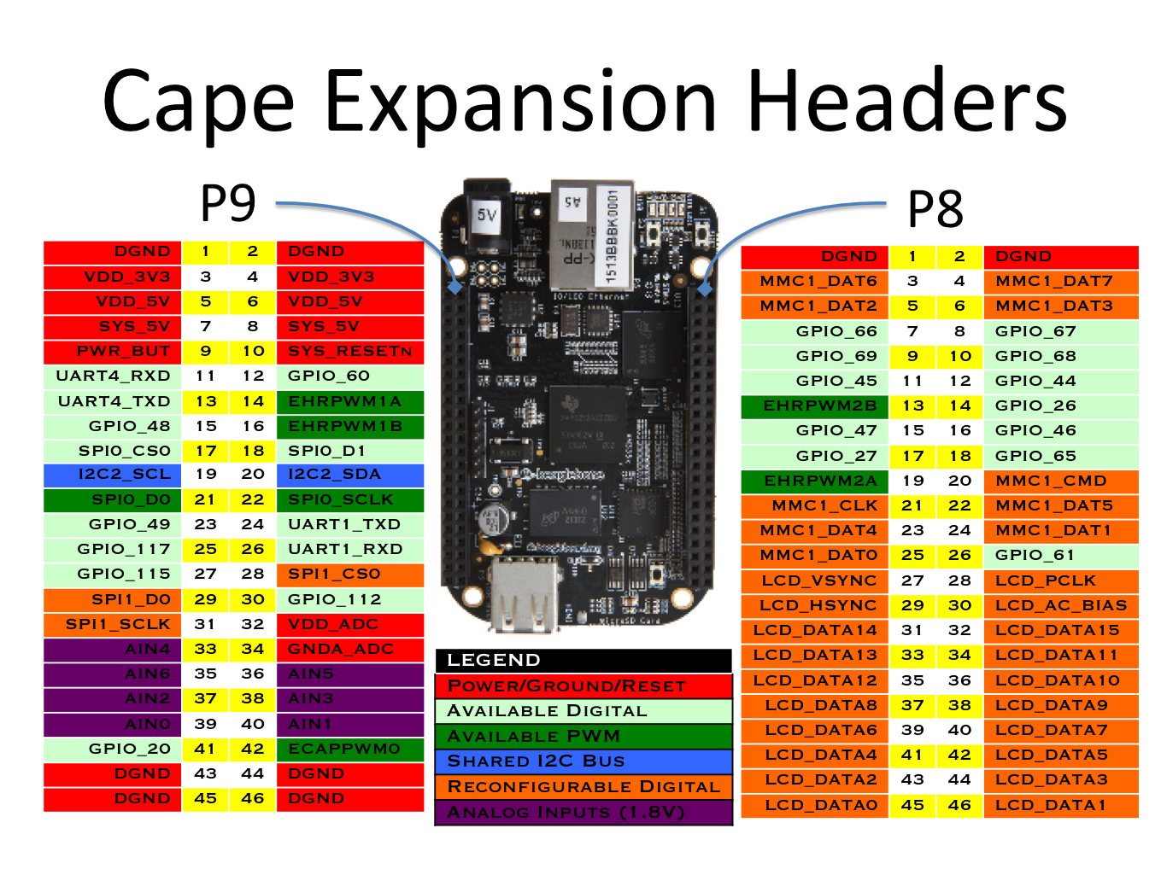
BBBW pin Congiguration

Slide 17
Connection for interfacing BBBW with MQ2
Pin Vcc of MQ2 module with pin P9_5 or 6 of BBBW
01
Pin GND of MQ2 module with pin P9_45 or 46 of BBBW
02
Pin A0 of MQ2 module with Pin P9_33/35/36/37/38/39/40 of BBW
03

Slide 18
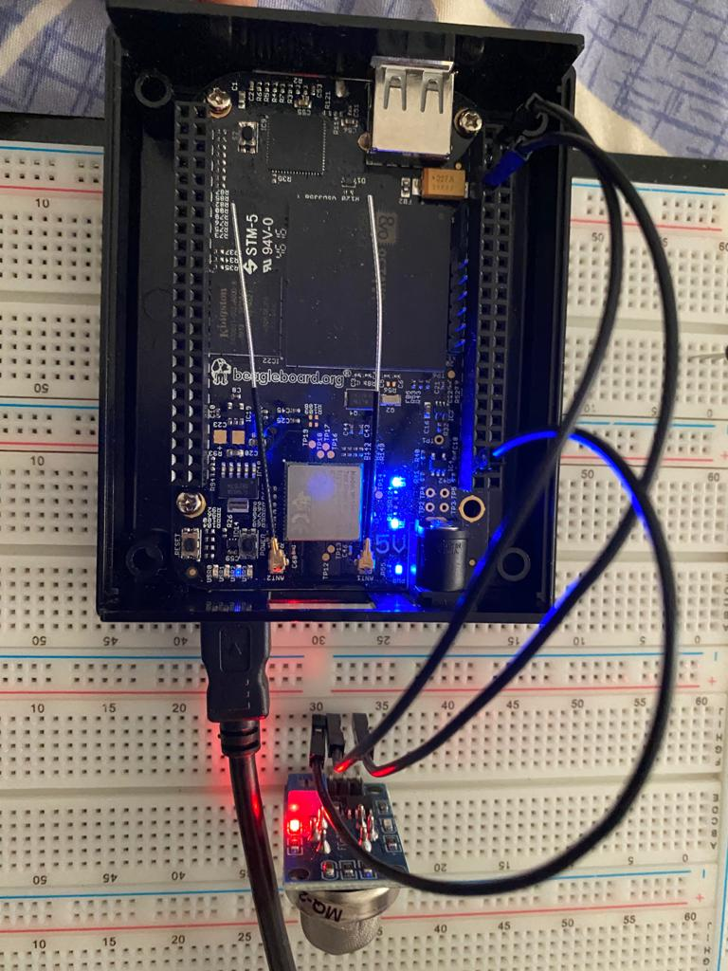

Slide 19
Calculation for MQ2 Sensor Data
Each of the gas sensors outputs an analog value from 0 to 4095. To convert this value into voltage, use the following equation.
Sensor Voltage = AnalogReading * 5V / 4095
CO sensor: PPM = 3.027*e^(1.0698*sensor Voltage)

Slide 20
CO concentration in Air
 | Concentration (ppm)
House Without LPG | 0.5 to 5 ppm
House with LPG cooking kit | 5 to 30 ppm
Dangerous Level | > 70 ppm
Fatal Or death level | > 150 ppm

Slide 21
Coding for Interfacing sensor with BBBW
#include <iostream> //provides basic input and output services for C++ programs.
#include <unistd.h> //provides access to the POSIX operating system API.
#include <fstream> //performs input/output operations on the file
#include <math.h> // for mathematical operation
using namespace std;
int sensor_val() // generating a function for smoke sensor
{
int Smoke_sensor; // generating a local variable to store sensor data
fstream f; // generating a stream for file
f.open("/sys/bus/iio/devices/iio:device0/in_voltage1_raw"); // config P9_40 AIN of BBBW
f>>Smoke_sensor; // giving file address to local variable
return (int)Smoke_sensor; //returning integer value to sensor_val function
}

Slide 22
Coding for Interfacing sensor with BBBW
int main()
{
float dex,sensor_output,b ; // declaring local variable
while(1)
{
dex= sensor_val();
b=dex;
b=(b/4);
if ((int)b>=300) // condition for threshold
cout<< "smoke detected "<< endl;

Slide 23
Coding for Interfacing sensor with BBBW
cout<< "smoke detected "<< endl;
dex=(dex/4096)*5; //converting sensor analog value in voltage
sensor_output=3.027*exp(1.0698*dex); // sensor output in ppm
cout<<"Smoke Sensor Data :" << sensor_output <<"ppm"<< endl;
system("sleep 1"); // putting system to sleep for 1 sec
}
return 0;
}

Slide 24
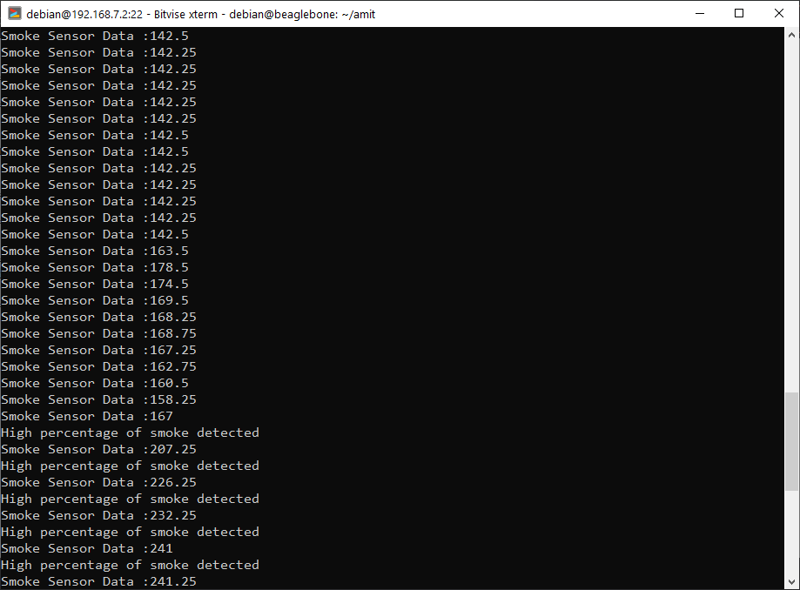
OUTPUT on BBBW terminal

Slide 25
References
Information about MQ2
https://datasheetspdf.com/pdf/622943/Hanwei/MQ-2/1
https://www.pololu.com/file/0J309/MQ2.pdf
https://components101.com/sensors/mq2-gas-sensor
https://www.google.com/search?q=internal+circuit+of+MQ2&tbm=isch&ved=2ahUKEwjO6__imszvAhVNXqwKHVTgBNYQ2-cCegQIABAA&oq=internal+circuit+of+MQ2&gs_lcp=CgNpbWcQAzoHCCMQ6gIQJzoFCAAQsQM6AggAOgQIIxAnOgQIABBDOgcIABCxAxBDOgYIABAIEB46BAgAEBhQg9oaWKGzG2CduRtoAXAAeACAAWSIAa4OkgEEMjIuMZgBAKABAaoBC2d3cy13aXotaW1nsAEKwAEB&sclient=img&ei=nOhcYM6tJs28sQXUwJOwDQ&bih=577&biw=1199&rlz=1C1OPNX_enCA942CA942#imgrc=ExlkoYd7HODtIM

Slide 26
References
Interfacing with BBBW
https://www.google.com/search?q=pin+configuration+of+beaglebone+black+wireless&rlz=1C1OPNX_enCA942CA942&sxsrf=ALeKk00L_f3va7iF8YNUDGVxNAhbkXN8Cg:1616706352798&source=lnms&tbm=isch&sa=X&ved=2ahUKEwjL2vS-rMzvAhXEUjUKHfbfBF4Q_AUoAXoECAEQAw&biw=1199&bih=577#imgrc=khtMprSXptDN-M
https://subscription.packtpub.com/book/hardware_and_creative/9781783986026/1/ch01lvl1sec09/setting-up-the-hardware

Slide 27
Reference
CO levels in ppm
https://www.epa.gov/indoor-air-quality-iaq/what-average-level-carbon-monoxide-homes#:~:text=Average%20levels%20in%20homes%20without,be%2030%20ppm%20or%20higher.
https://www.cpsc.gov/Safety-Education/Safety-Education-Centers/Carbon-Monoxide-Information-Center/Carbon-Monoxide-Questions-and-Answers

Slide 28
Reference
How to set threshold val for sensor
https://create.arduino.cc/projecthub/biharilifehacker/how-to-make-smoke-detector-alarm-1c322b?ref=user&ref_id=1321915&offset=1

Slide 29

Questions?

Slide 30

Thank You!

